Slide 1

CSC6052/5051/4100/DDA6307/MDS5110 Natural Language Processing
Tutorial 6: RLHF
Spring 2024
Benyou Wang
School of Data Science

Slide 2


Self Introduction
A Second-Year PHD
Towards Better Human-AI Collaboration, especially in Medicine
CMB, Apollo, LongLLaVA, ApolloMoE, TinyDeepSeek ...
https://github.com/wangxidong06
https://github.com/wangxidong06

Slide 3
Context
RLHF Theory
Recall LLM's Loss Func: CrossEntropy
Basic RL Loss Derivation
Variants of the Basic RL and their motivations
Reward Model Training
Colab Practice

Slide 4
Context
RLHF Theory
Recall LLM's Loss Func: CrossEntropy
Basic RL Loss Derivation
Variants of the Basic RL and their motivations
Reward Model Training
Colab Practice

Slide 5
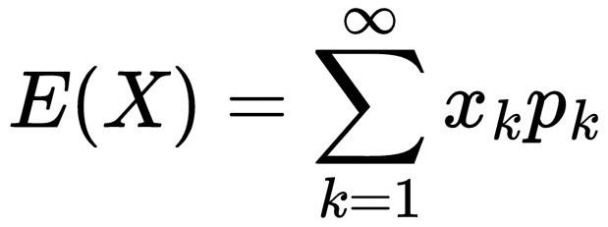
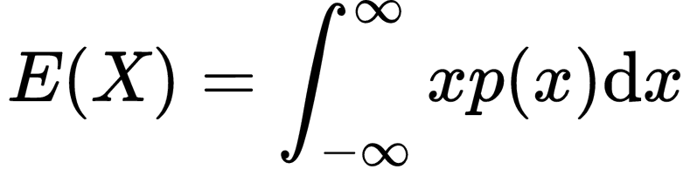
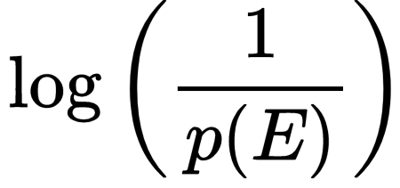
What’s Entropy?
“Theoretical average” of “surprising degree” of an event
“average”: Expectation
“surprising degree”: Self-information
What’s Expectation?
The average value of a random variable
(Discrete)
(Continuous)
What’s Self-information?
Surprisal
Core Idea: "informational value" of a message depends on the message’s “surprising” degree.
When p(E) is close to 1, the surprisal of the event is low
Why Log?

Slide 6
Why Log?
What’s Self-information?
Surprisal
Core Idea: "informational value" of a message depends on the message’s “surprising” degree.
When p(E) is close to 1, the surprisal of the event is low
Fundamental properties of Self-information:
I(p) is monotonically decreasing in p: an increase in the probability of an event decreases the “surprising degree” from an observed event, and vice versa.
I(1) = 0: events that always occur do not communicate information.
I(p₁·p₂) = I(p₁) + I(p₂): the information learned from independent events is the sum of the information learned from each event.
In fact, log is the only function that satisfies these specific set of properties

Slide 7
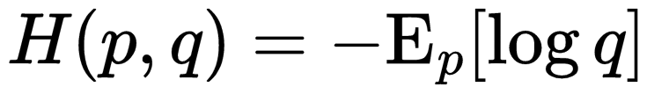
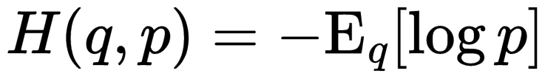
What’s CrossEntropy
Entropy: “Theoretical average” of “surprising degree” of an event
CrossEntropy: “Theoretical average” “surprising degree” when a wrong distribution q
is assumed while the data actually follows a distribution p.
Why not use ?
When you learn knowledge from the world:
“surprising degree”: You’re the q, You’re the observer. You’re the one who get surprised.
The surprising degree is depend on you.
“Theoretical average” : What you gain by observing is depends on real distribution “God” p.

Slide 8
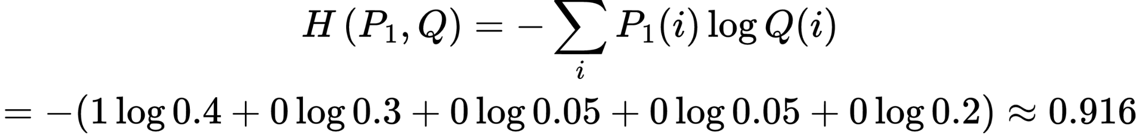
What’s CrossEntropy
CrossEntropy: Theoretical “average” “surprising degree” when a wrong distribution q
is assumed while the data actually follows a distribution p.
Label’s Distrubution：
Animal Label | Dog [1.0.0.0.0] | Fox [0.1.0.0.0] | Horse [0.0.1.0.0] | Eagle [0.0.0.1.0] | Squirrel [0.0.0.0.1]
Prediction for Label “Dog”：
Model | Prediction
Q | [0.4, 0.3, 0.05, 0.05, 0.2]
Prediction for Next-Token is the same
Training Goal: Minimize the theoretical average “surprising degree” to Learn the real distribution of Natural Language Tokens with Next-Token Prediction Task

Slide 9
Context
RLHF Theory
Recall LLM's Loss Func: CrossEntropy
Basic RL Loss Derivation
Variants of the Basic RL and their motivations
Reward Model Training
Colab Practice

Slide 10
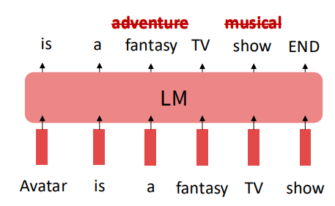
Limitations of CrossEntropy?
CrossEntropy Loss for LLM Training
Training Goal: Minimize the “Theoretical average” “surprising degree” to Learn the real distribution of Natural Language Tokens with “Next-Token Prediction” Task
Core Problem: P always be 0/1 distribution [0,..,0,1,0,..,0] but it’s not “real”
Problem 1: tasks like open-ended creative generation have no right answer.
Write me a story about a dog.
Problem 2: language modeling penalizes all token-level mistakes equally, but some errors are worse than others.
Can we explicitly attempt to satisfy human preferences?

Slide 11
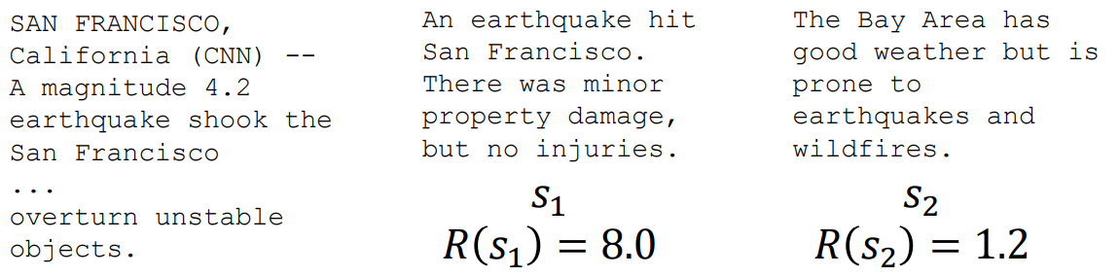
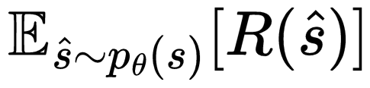
Optimizing for human preferences
Let’s say we were training a language model on some task (e.g. summarization)
For each LM sample 𝑠, imagine we had a way to obtain a human reward: 𝑅(𝑠) ∈ ℝ
Now we want to maximize the expected reward of samples from our LM:

Slide 12
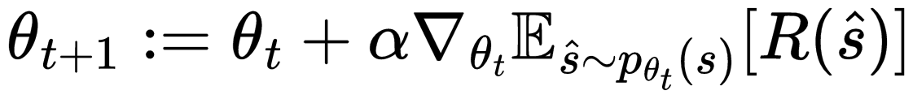
Optimizing for human preferences
How do we actually change our LM parameters 𝜃 to maximize this?
Let’s try doing gradient ascent!
What if our reward function is nondifferentiable (rule-based)??

Slide 13
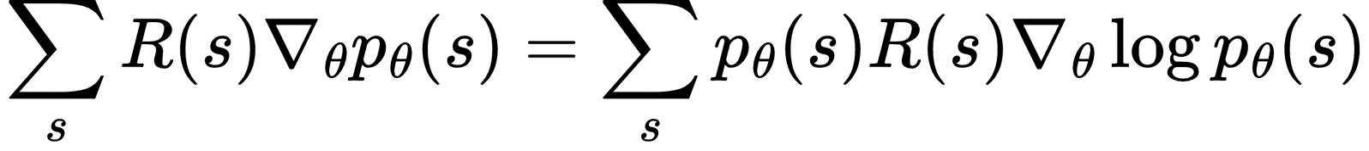
Optimizing for human preferences
What if our reward function is nondifferentiable (rule-based)??
(1)
Anyway, let's play with the gradient and see what happens.
(2)
Here Comes a very common trick for ML:
(3)
Bring (3) into (2):

Slide 14
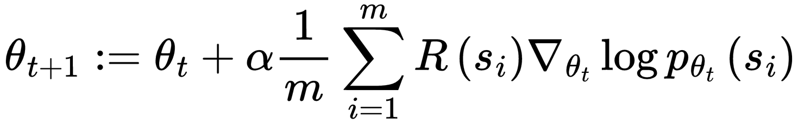
Optimizing for human preferences
REINFORCE
From the perspective of Loss：
REINFORCE is Just reward weighted CrossEntropy Loss.
CrossEntropy Loss is REINFORCE with All rewards to be 1.
CrossEntropy Loss for LLM Training
Core Problem: P always be 0/1 distribution [0,..,0,1,0,..,0] but it’s not “real”

Slide 15
Optimizing for human preferences
REINFORCE
From the perspective of Loss：
REINFORCE is Just reward weighted CrossEntropy Loss.
CrossEntropy Loss is REINFORCE with All rewards to be 1.
CrossEntropy Loss for LLM Training
Why it’s called “reinforcement learning”:
we reinforce good actions, increasing the chance they happen again.
If 𝑅 is +++ Take gradient steps to maximize 𝑝𝜃
If 𝑅 is --- Take steps to minimize 𝑝𝜃

Slide 16
Context
RLHF Theory
Recall LLM's Loss Func: CrossEntropy
Basic RL Loss Derivation
Variants of the Basic RL and their motivations
Reward Model Training
Colab Practice

Slide 17
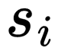
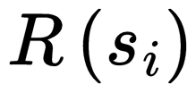
Some boring but confusing terms about RL
From the perspective of Loss：
REINFORCE is Just reward weighted CrossEntropy Loss.
CrossEntropy Loss is REINFORCE with All rewards to be 1.
The following definitions are only within RLHF Training context:
Policy/Actor Model: LLM who generate next token
Online/On-Policy: the is from the current Model (Policy).
Offline/Off-Policy: the is not from the current Model (Policy).
Model-Base: Using a Model as simulated environment, not related to current RLHF.
Model-Free: Interact with environment and get the response reward, currently pattern.
Reward model, Value/Critic model, Verify model
reward model: Score the string
value/critic model: Reward model + updated during training + focus on future
verify model: Reward model + Completely accurate
Outcome-supervised Reward Model (ORM) /Process-supervised Reward Model (PRM)
ORM: is the same for different tokens of s
PRM: is different for different tokens of s

Slide 18
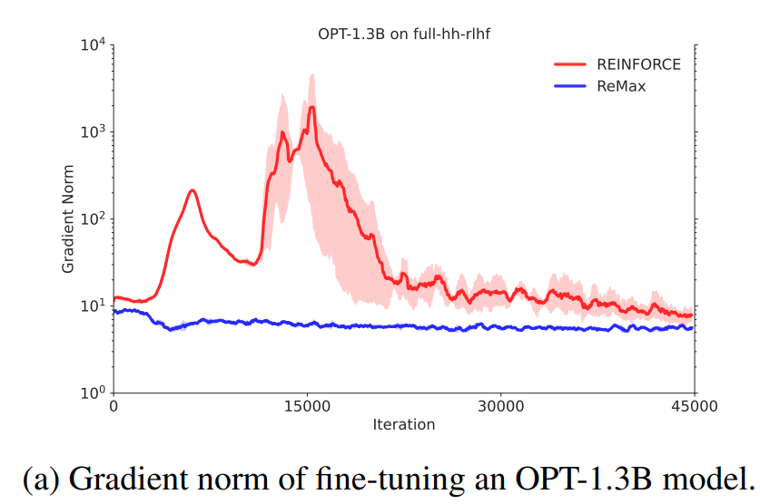
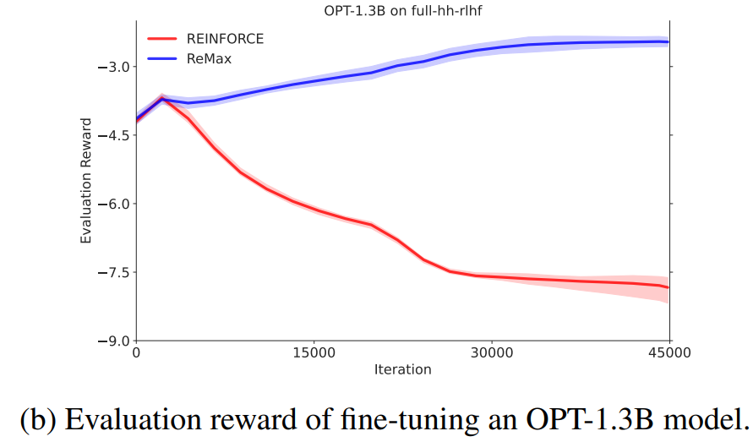
What’s wrong with REINFORCE?
Unstable!
The REINFORCE gradient estimator suffers from high variance [1], which undermines the effectiveness of model training and leads to suboptimal performance in RLHF tasks.
Below Results are from Remax: [2]
[1]. Sutton, Richard S., and Andrew G. Barto.Reinforcement learning: An introduction. MIT press, 2018.
[2]. https://arxiv.org/abs/2310.10505

Slide 19
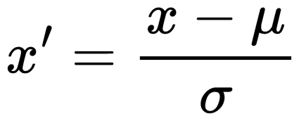
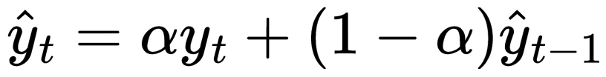
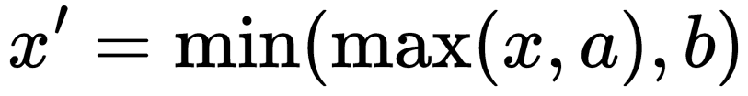
How to to enhance training stability?
To enhance training stability by reducing the variance in gradient estimation:
How to reduce the variance of a certain data from a statistical perspective?
Normalization:
Smoothing:
Truncation:
We will use these tricks/insights one by one !

Slide 20
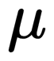
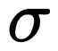
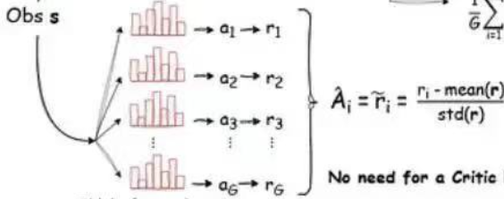
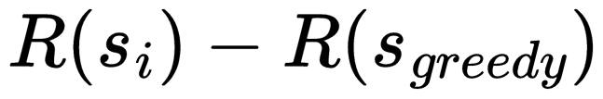
How to to enhance training stability?
Normalization!
what are approximate of and for , since we only know after training?
DeepSeek GRPO’s approximate [1]:
For one question, the model generates many answers for Training
So DeepSeek choose to Normalize within this small range.
Remax’s approximate [2]:
No need to use , just introduce baseline function
[1]. https://arxiv.org/abs/2402.03300
[2]. https://arxiv.org/abs/2310.10505

Slide 21
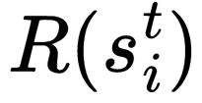
Normalization!
How to to enhance training stability?
Remax’s approximate [1]:
No need to use , just introduce baseline function
How about the baseline function is also a neural network, so that we can reduce the variance of gradient estimation? Actor-Critic Algorithm
We call the baseline neural network as Value/Critic Model,
and get another approximation of Advantage:
Just another approximation of R ,
but expressed as the difference between two neural networks.
V is expected sum of future actions’ score
[1]. https://arxiv.org/abs/2310.10505

Slide 22
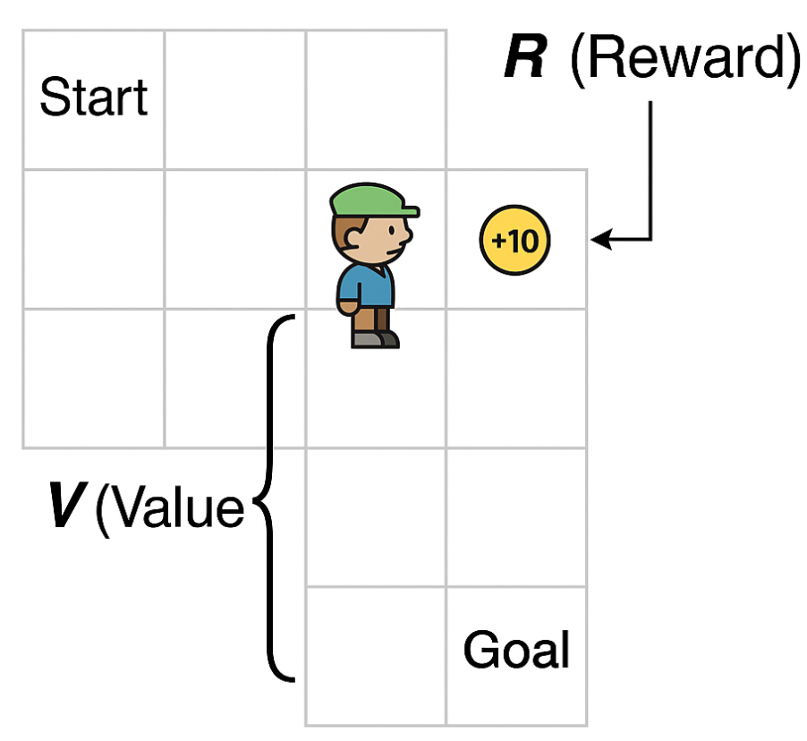
Normalization!
How to to enhance training stability?
We call the baseline neural network as Value/Critic Model,
and get another approximation of :
V is expected sum of future actions’ score
Just another approximation of R, but expressed as the difference between two neural networks.
But now there are still two intuitive questions:
Why this approximation of R’s variance smaller?
How to train value model?

Slide 23
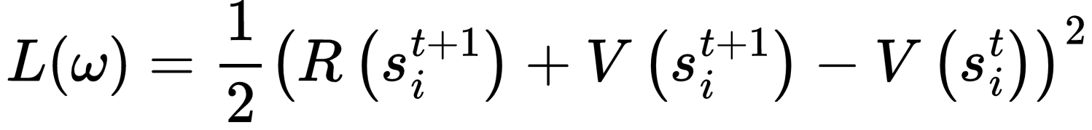
How to to enhance training stability?
Normalization!
We call the baseline neural network as Value/Critic Model,
and get another approximation of
But now there are two very intuitive questions:
Why is the variance smaller?
Assume X and Y are not independent and from same distribution
where 𝜌 is the correlation coefficient.
if ρ=1: Perfectly positively correlated, the variance is 0
How to train value model?
My Opinion:There is a huge RLHF-specific problem here (caused by the bias in reward definition) !

Slide 24
How to to enhance training stability?
Normalization!
We call the baseline neural network as Value/Critic Model,
and get another approximation of
But now there are two very intuitive questions:
Why is the variance smaller?
Assume X and Y are not independent and from same distribution
where 𝜌 is the correlation coefficient.
if ρ=1: Perfectly positively correlated, the variance is 0
How to train value model?
My Opinion: Maybe this is right

Slide 25
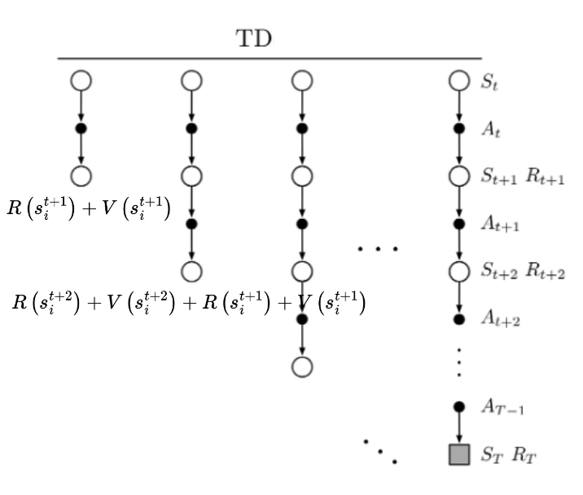
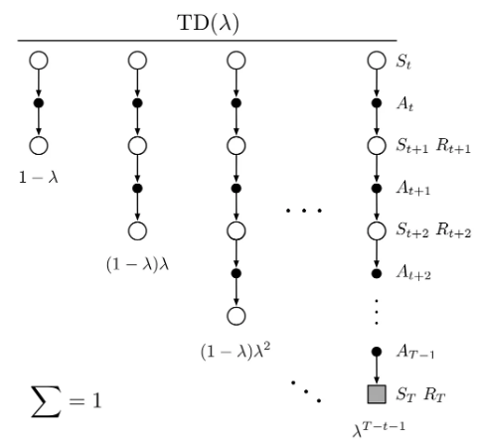
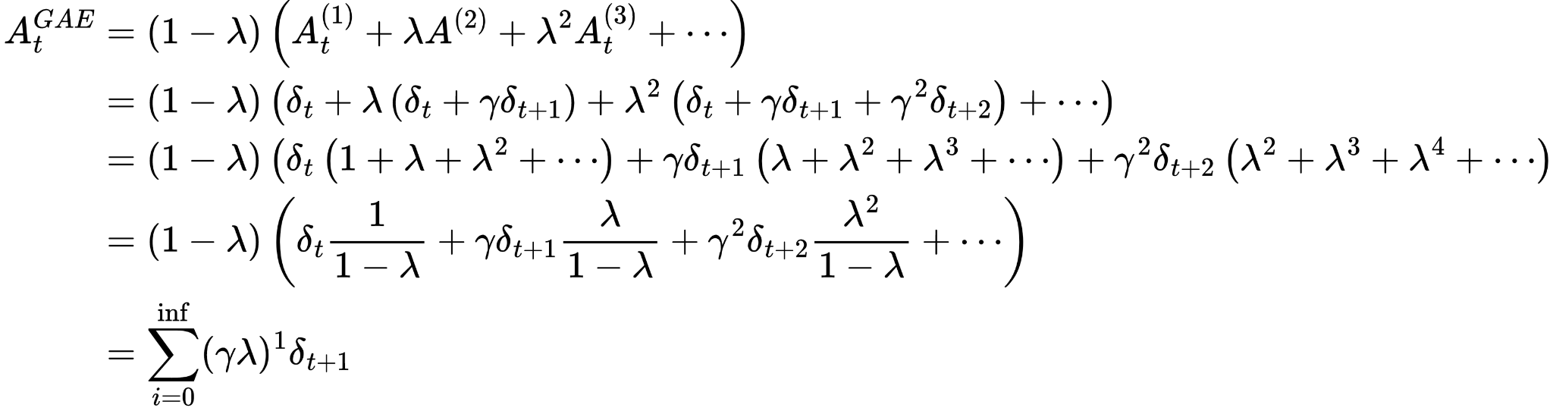
Smoothing !
How to to enhance training stability?
approximation of final goal
Generalized Advantage Estimation (GAE):
Apply exponential smoothing on temporal differences (TD) with different step

Slide 26
How to to enhance training stability?
To enhance training stability by reducing the variance in gradient estimation:
How to reduce the variance of a certain data from a statistical perspective?
Normalization:
Smoothing:
Truncation:
We will use these tricks/insights one by one !

Slide 27
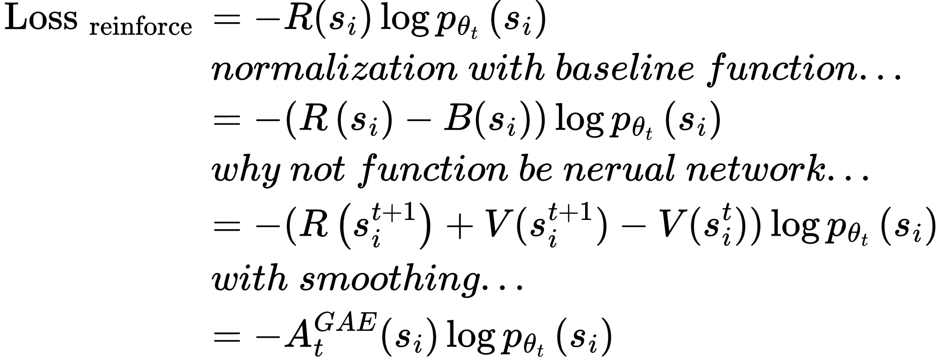
How to to enhance training stability?
Actor-Critic Algorithm
Still Unstable for traditional RL? Truncation !

Slide 28
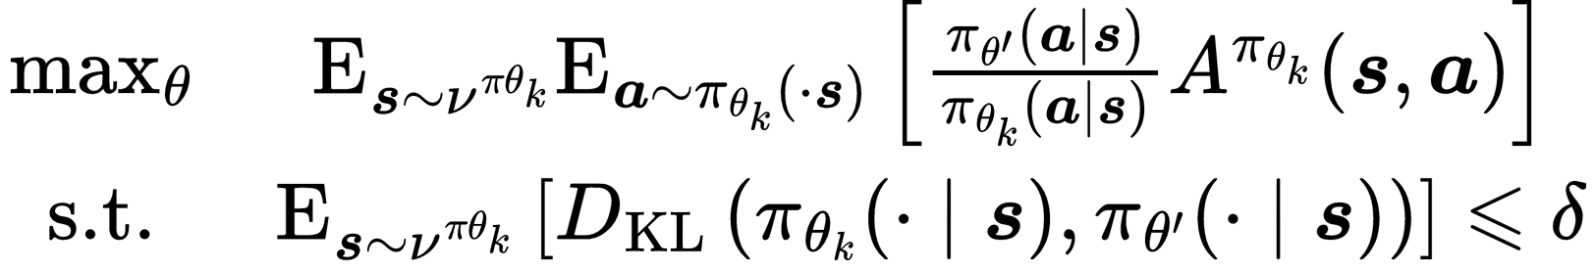
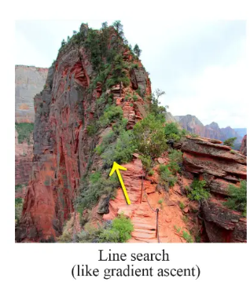
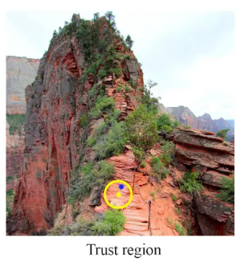

Truncation !
How to to enhance training stability?
Actor-Critic Algorithm
Trust Region Policy Optimization （TRPO）
Aiming to climb the mountain as quickly as possible while ensuring stability and avoiding any risk of falling.
Motivation:

Slide 29
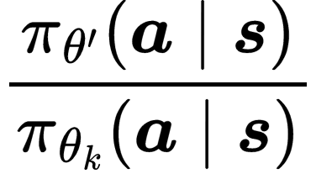
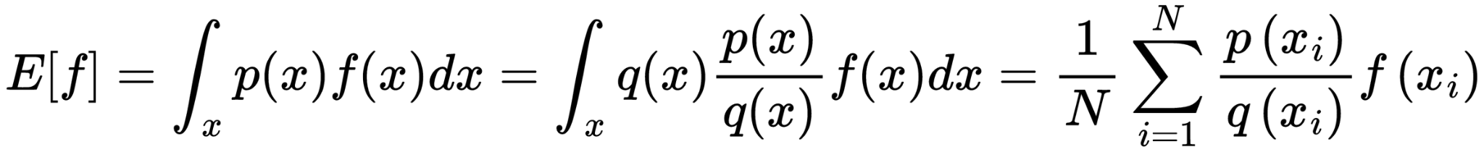
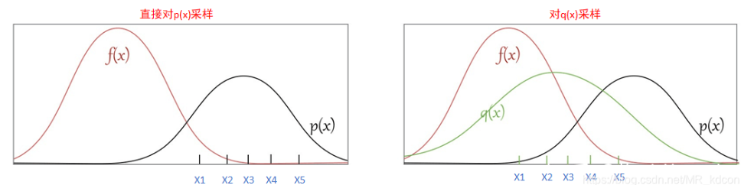
Truncation !
How to to enhance training stability?
Actor-Critic Algorithm
Trust Region Policy Optimization （TRPO）
Importance Sampling Correction Factor
Importance Sampling:

Slide 30
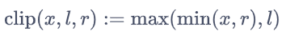
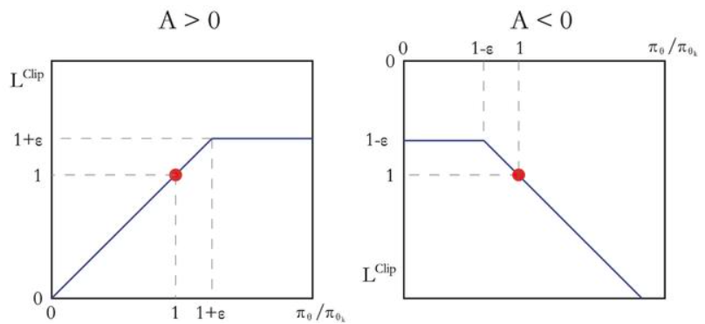
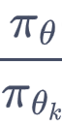
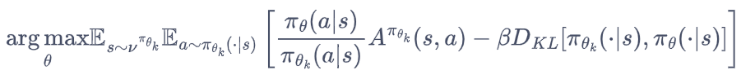
Truncation !
How to to enhance training stability?
Trust Region Policy Optimization （TRPO）
PPO’s Motivation: Simplified TRPO
Proximal Policy Optimization Algorithms （PPO-CLIP）
If A> 0, it indicates that the value of this action is above average. Maximizing this term will increase , but it will not exceed 1+ε.
if A<0, maximizing this term will decrease , but it will not be less than 1-ε
PPO-Penalty

Slide 31
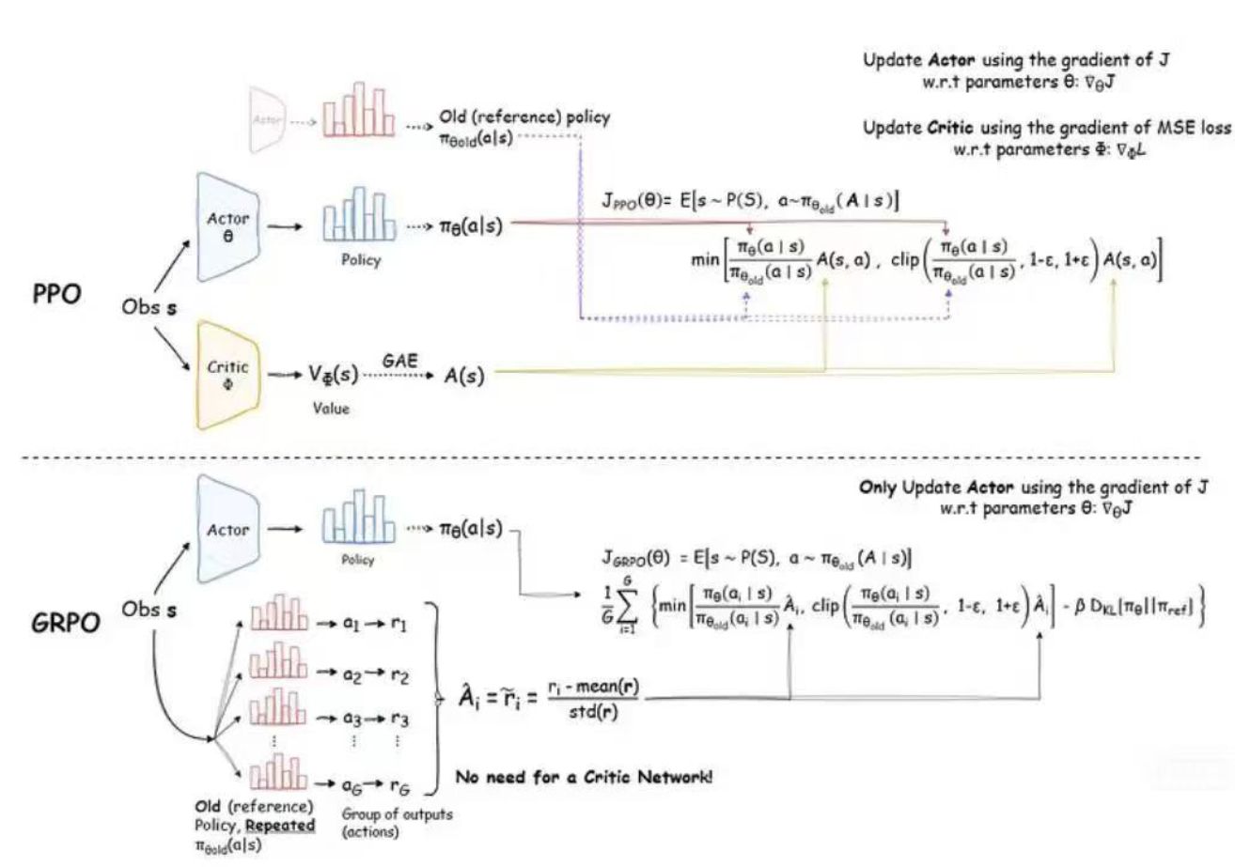
Differences between the two most popular algorithms:

Slide 32
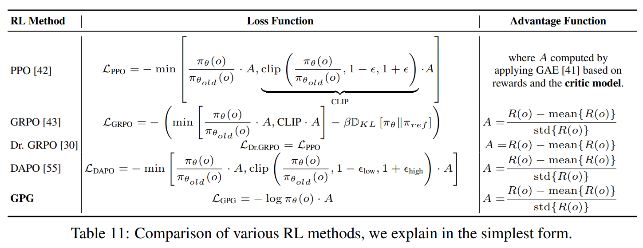
Differences between recent new varients:
[1]. https://arxiv.org/pdf/2504.02546

Slide 33
Context
RLHF Theory
Recall LLM's Loss Func: CrossEntropy
Basic RL Loss Derivation
Variants of the Basic RL and their motivations
Reward Model Training
Colab Practice

Slide 34
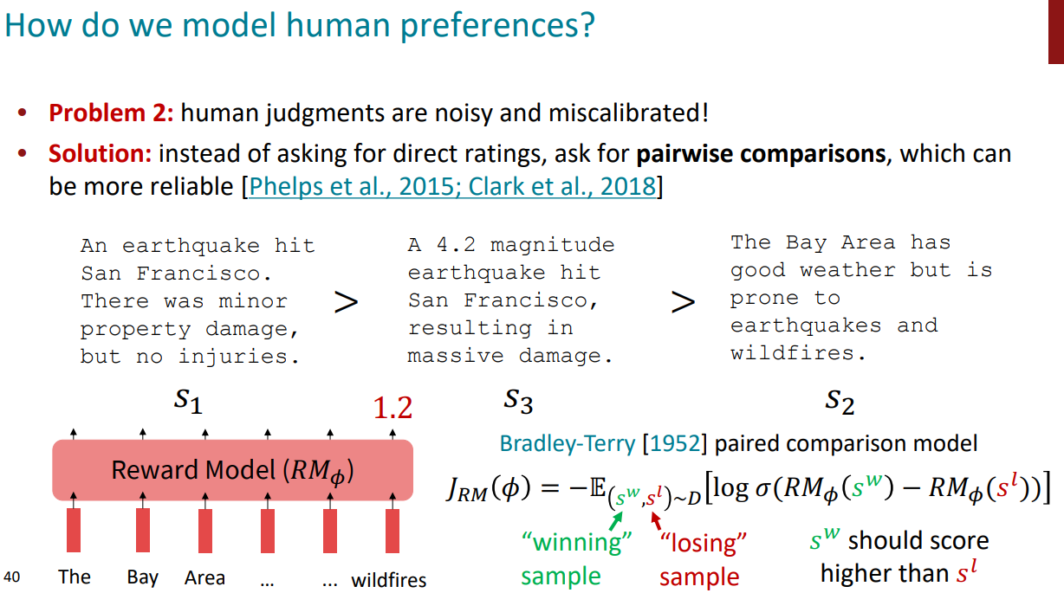
https://web.stanford.edu/class/archive/cs/cs224n/cs224n.1244/slides/cs224n-2024-lecture10-instruction-tuning-rlhf.pdf

Slide 35
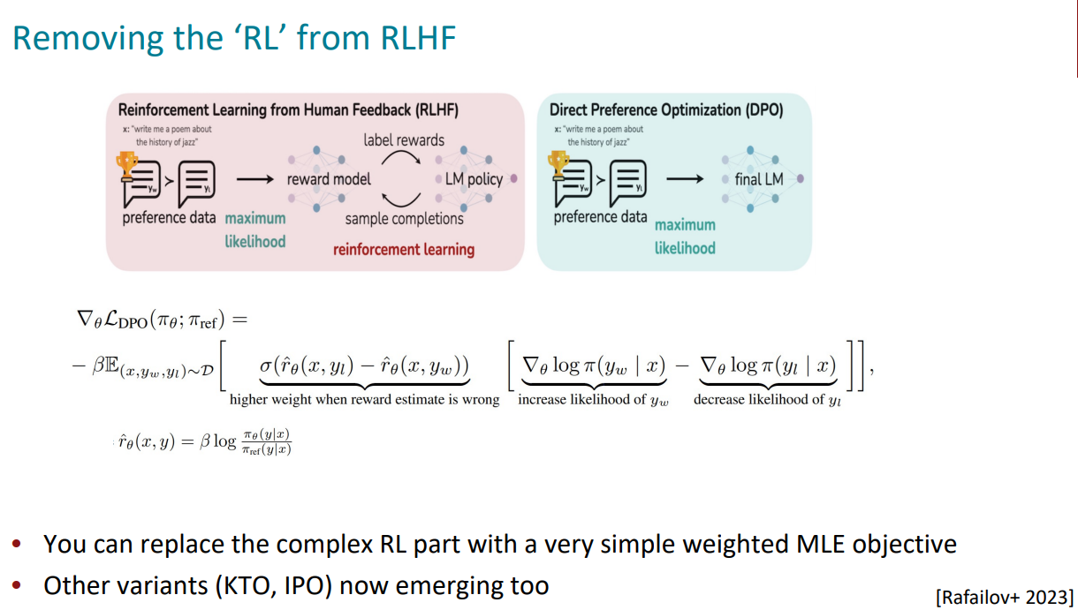
https://web.stanford.edu/class/archive/cs/cs224n/cs224n.1244/slides/cs224n-2024-lecture10-instruction-tuning-rlhf.pdf

Slide 36
Context
RLHF Theory
Recall LLM's Loss Func: CrossEntropy
Basic RL Loss Derivation
Variants of the Basic RL and their motivations
Reward Model Training
Colab Practice

Slide 37
Training Frameworks
Using notebooks for long-term model training is inconvenient in some cases. You can also try the following alternative model training frameworks:
Verl: https://github.com/volcengine/verl
OpenRLHF: https://github.com/OpenRLHF/OpenRLHF
trl: https://github.com/huggingface/trl
MS-SWIFT: https://github.com/modelscope/ms-swift
Light-R1: https://github.com/Qihoo360/Light-R1
DeepScaler:https://github.com/agentica-project/rllm

Slide 38
Practice of RLHF
If you're new to using LLMs, don't worry; we've prepared a notebook for you:
https://colab.research.google.com/drive/1zzbNse317ZOkyI5EnPbzd50fA-srELFW?usp=sharing
1. DPO
2. GRPO
This will guide you train on

Slide 39
Thanks

